Slide 1

Permanent Magnet Demagnetization Induced by high energy electron radiation*
Temnykh
CLASSE & CHESS Laboratory, Cornell University, Ithaca, NY, 14853, USA
*This work was supported by NSF awards DMR-0936384 and DMR-0807731

Slide 2
Presentation outline
Scope of experimental data and observations.
  PM undulator radiation damage at APS
  PM demagnetization study at SPing8
  Experimental study at Cornell
Analysis and Discussion
Conclusion

Slide 3
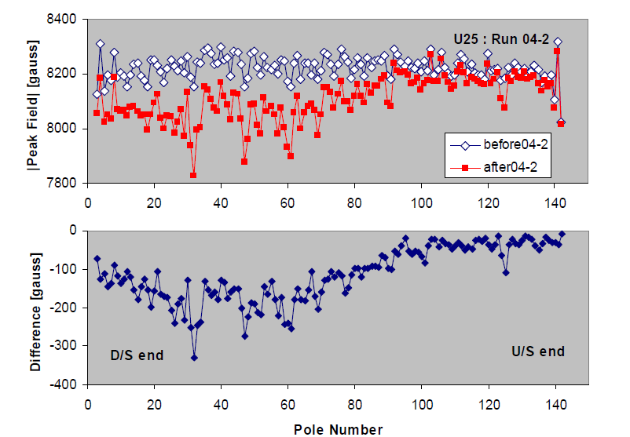
PM undulator radiation damage at APS, ref [1]
Found that PM blocks were demagnetized in regions close to the beam axis. This indicates that the damage is due to electromagnetic showers coupled with photo-hadron production, but not due to neutrons. (Two competing theories)
~2.4%
Beam direction
There is no data on accumulated dose
Magnetic field degradation in U25 undulator during 4 month run (May-August 2004)
[1] S. Sasaki, et al., Radiation damage to advanced photon source undulators, In Proceedings of 2005 PAC, Knoxville, TN, p. 4126.

Slide 4
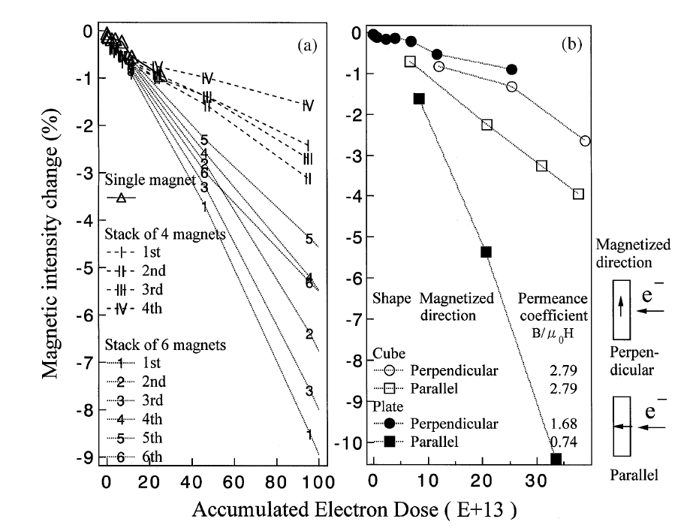
Study at SPing8/Pohang Accelarator laboratory
Direct irradiation by 2GeV electron beam, ref [2]
Permanent magnet blocks were irradiated by 2.0GeV electron beam from the linac of Pohang Accelarator laboratory.
Various arrangements and materials
Factor 10 (!) for plate with parallel and perpendicular magnetization but not big difference for cube.
[2] T. Bizen et al. / Demagnetization of undulator magnets irradiated by high energy electrons, Nuclear Instruments and Methods in Physics Research A 467–468 (2001) 185–189

Slide 5
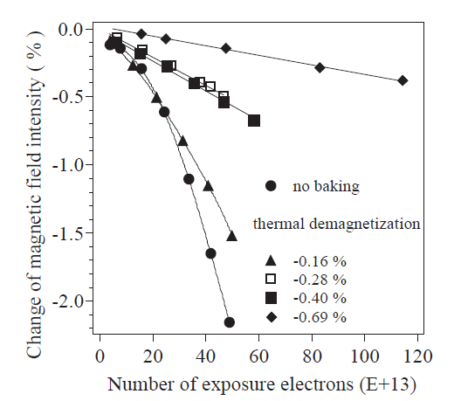
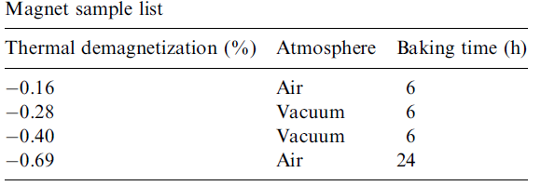
Study at SPing8/Pohang Accelarator laboratory
Heat treatment effect, ref [3]
Permanent magnet blocks were first baked at 142degC, then irradiated by 2.0GeV electron beam from the linac of Pohang Accelarator laboratory.
PM material: NdFeBr NEOMAX 35EH,
Hcj = 1989 kA/m
“ … This thermal treatment will be a good stabilizing method for magnets used in a high-irradiation environment.”
[3] T. Bizen et al. / Baking effect for NdFeB magnets against demagnetization
induced by high-energy electrons, Nuclear Instruments and Methods in Physics Research A 515 (2003) 850–852

Slide 6
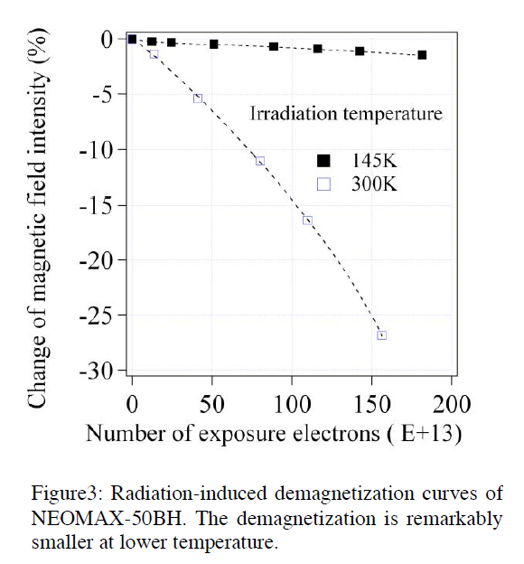
Study at SPing8/Pohang Accelarator laboratory
Low temperature effect, ref [4]
PM blocks were irradiated by 2.0GeV electron beam at room and low temperatures
PM Material NdFeB NEOMAX 50BH
At 300ºK, Hcj = 1116 kA/m
143ºK, Hcj = 3060 kA/m
At room temperature (300degK) PM material will be demagnetized by 1.4 T reverse field. At low (143degK) temperature, demagnetizing reverse field is 3.8T (x 2.7 higher!).
[4] T. Bizen et al. /Radiation Damage in Magnets for Undulators at Low Temperature, In Proceedings of EPAC 2004, Lucerne, Switzerland

Slide 7
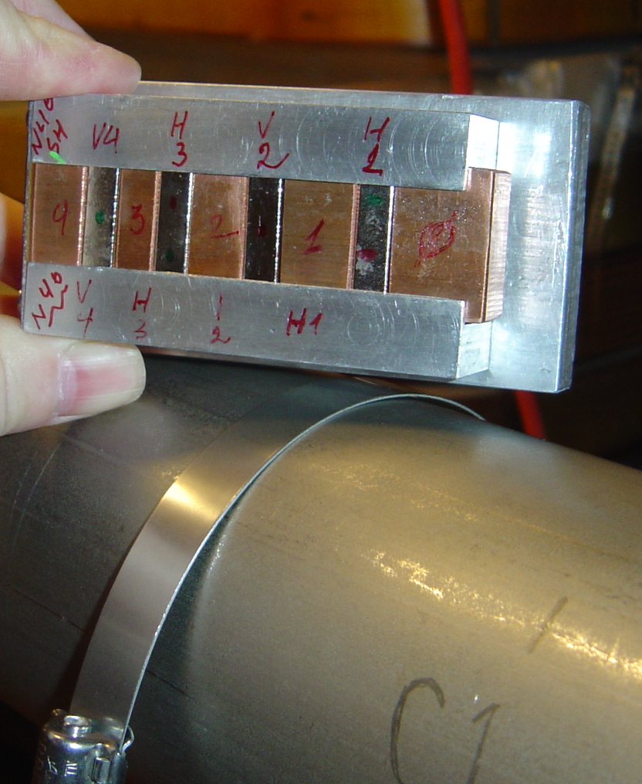
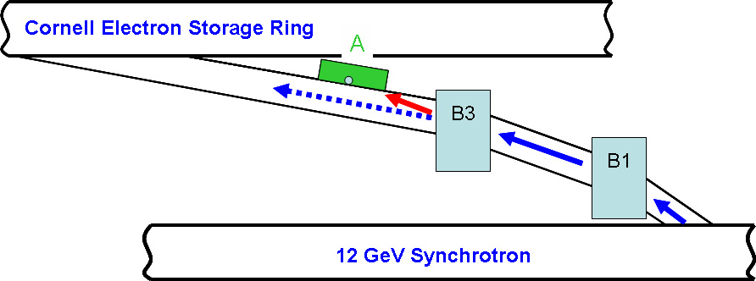
PM demagnetization study at Cornell
Setup
Copper spacers
East Transfer Line
PM blocks
PM assembly, on the right, was attached to the East transfer line beam pipe. Irradiation process was controlled by steering of electron beam on/off the assembly by bending magnet “B3”.
Transfer line
Beam pipe
[4] A. Temnykh, Measurement of NdFeB permanent magnets demagnetization induced
by high energy electron radiation, Nuclear Instruments and Methods in Physics Research A 587 (2008) 13–19

Slide 8
PM demagnetization study at Cornell
Irradiation process
D = 0.324Mrad
Single irradiation cycle assembly temperature record
(1) Electron beam tuned ON
(2) Electron beam OFF
Q – energy / radiation dose absorbed by material
C – material heat capacity (0.41J/g/degC)
11 irradiation cycles, total absorbed dose ~3.2 Mrad

Slide 9
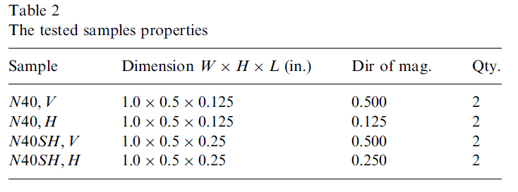
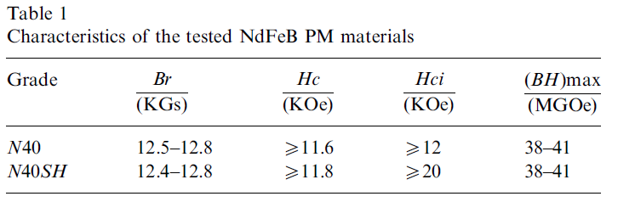
PM demagnetization study at Cornell
The tested samples properties
V - block
H - block

Slide 10
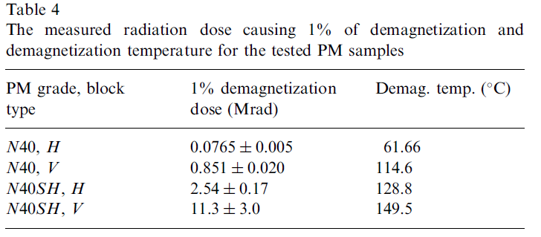
Magnetic moment change as a function of accumulated dose
Comparison with ref [2] data:
Material N35EH;
50x10¹³ electrons => ~3Mrad dose

Slide 11
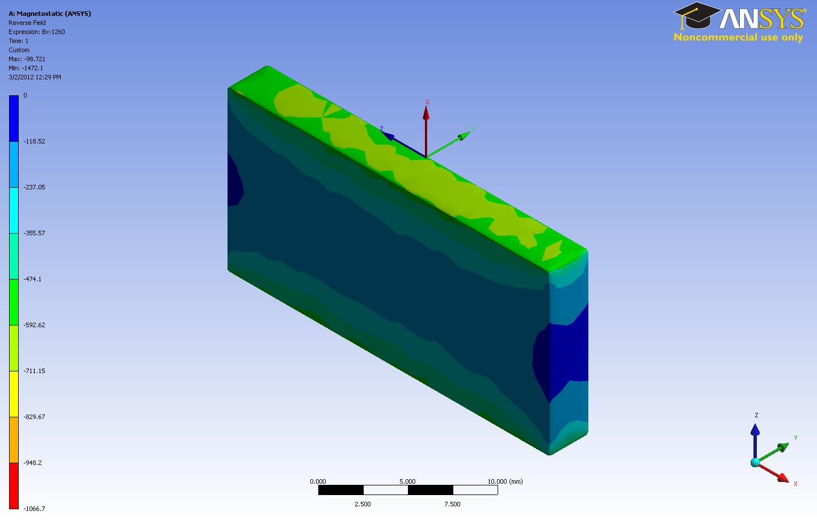
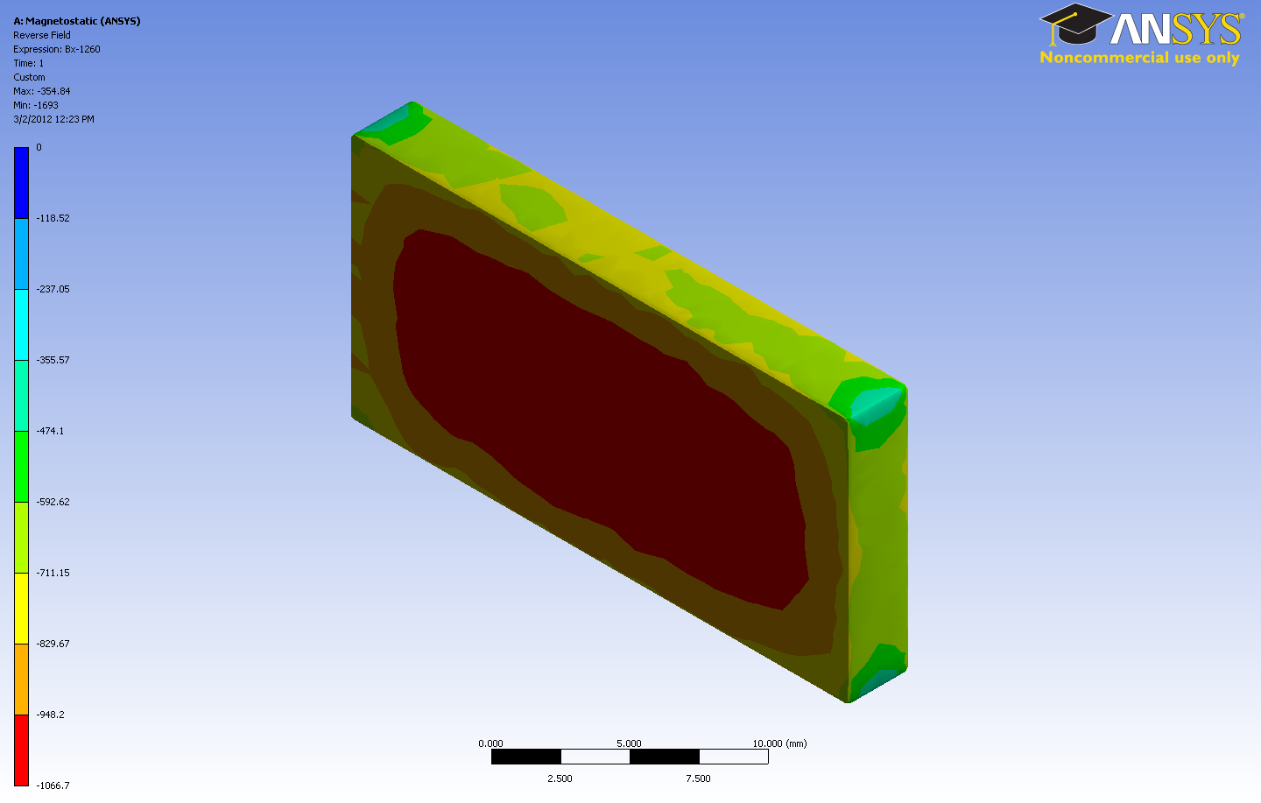
PM demagnetization study at Cornell
Reverse field distribution for V and H blocks
Reverse field
~5kOe
H-block
V-block
Reverse field
~0
Reverse field ~11kOe
PM grade, block type | Hci(kOe) | Reverse Field(kOe) | Demag. Temp. (⁰C)
N40, H | ~12 | 11 | 61.66
N40, V | ~12 | 6.1 | 114.6
N40SH, H | ~20 | 8.62 | 128.8
N40SH, V | ~20 | 6.68 | 149.5

Slide 12
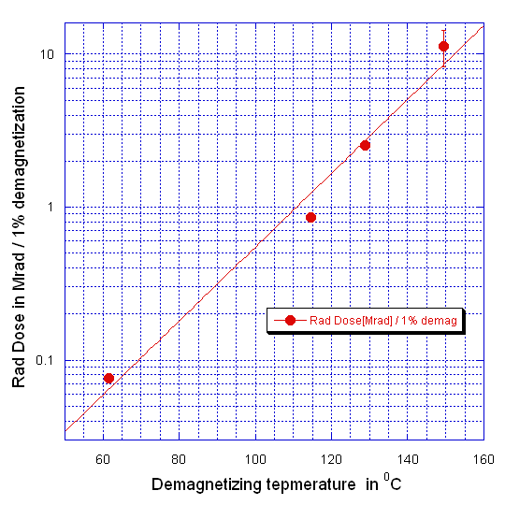
Correlation between demagnetizing radiation dose and demagnetizing temperature
Device, more resistive to temperature demagnetization, will be more resistive to radiation.

Slide 13

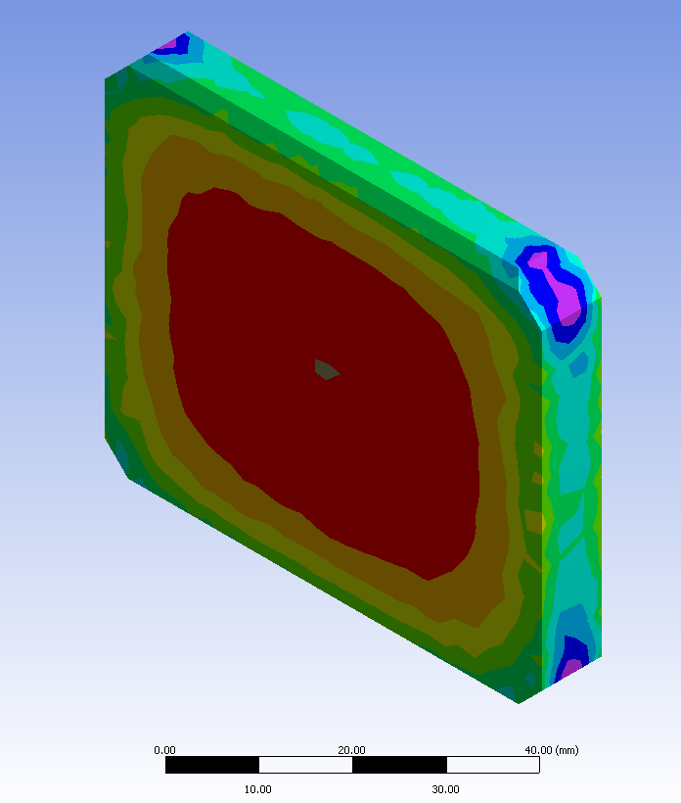

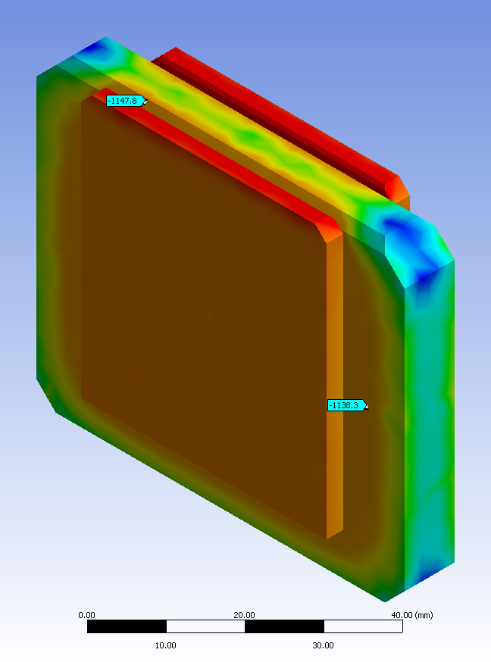
Damaging doses estimation for LCLS undulator magnets.
Reverse field [mT]
Single PM block
Reverse field [mT]
Half period
Reverse field maximum 1105 mT
Reverse field
maximum
~ 1075mT
For material N40SH (?)
Tdmg = 110degC, D1% ~ 1Mrad
Tdmg = 110degC, D1% ~ 1Mrad

Slide 14
Conclusion
Recipe to maximize radiation resistivity
    Use material with high Hcj
    Minimize reverse field in design
    Heat treat blocks before assembly
    Lower operating temperature
Correlation between demagnetization temperature and radiation dose can be used to predict/estimate the damaging radiation dose at design stage. Accuracy?
Thank you

